Slide 1

Algebra 1
Unit 11, Lesson 1 Exploring Exponential Growth Versus Decay Volume 2, pg. 155

Slide 2


Benchmark
MA.912.AR.5.3
Given a mathematical or real-world context, classify exponential functions as representing growth or decay.
volume 2, pg. 155

Slide 3
Integrated Mathematical Thinking and Reasoning Standards
MA.K12.MTR.1.1 Actively participate in effortful learning both individually and collectively.
MA.K12.MTR.2.1 Demonstrate understanding by representing problems in multiple ways.
MA.K12.MTR.4.1 Engage in discussions that reflect on the mathematical thinking of self and others.
MA.K12.MTR.5.1 Use patterns and structure to help understand and connect mathematical concepts.
MA.K12.MTR.7.1 Apply mathematics to real-world contexts.
volume 2, pg. 155

Slide 4

Learning Targets
I can classify a function as representing exponential growth or decay from a graph.
I can classify a function as representing exponential growth or decay from a table.
volume 2, pg. 155

Slide 5

Warm-Up
volume 2, pg. 155

Slide 6
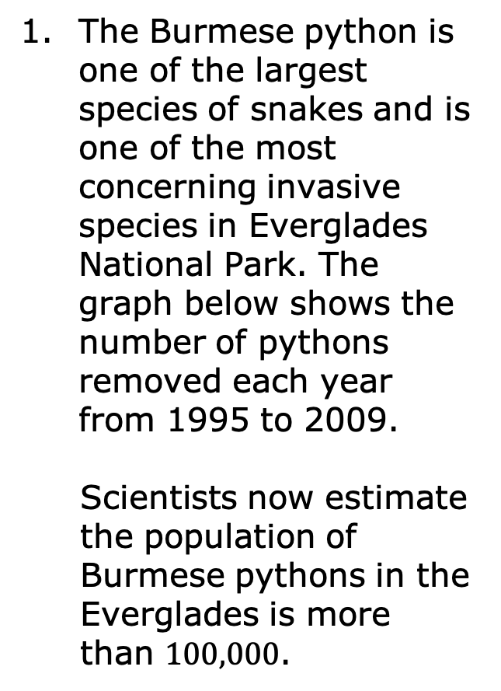
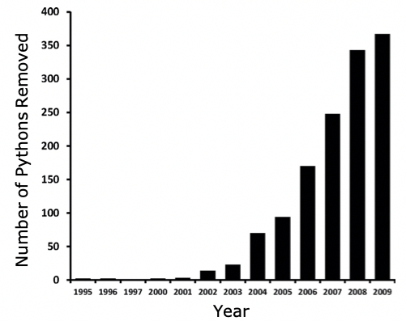
11.1.1 Warm-Up: Invasive Snakes
volume 2, pg. 155

Slide 7
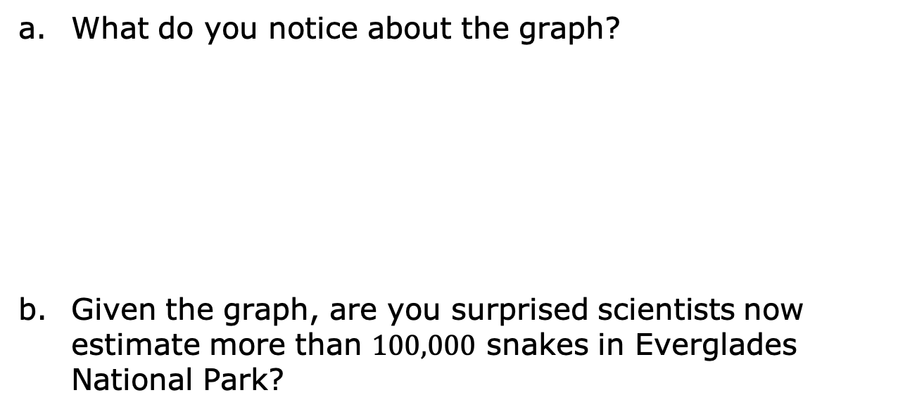
volume 2, pg. 155

Slide 8

Exploration
volume 2, pg. 156

Slide 9

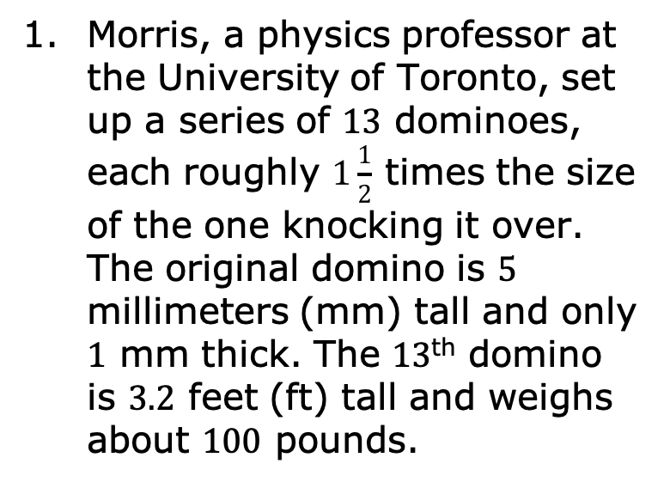
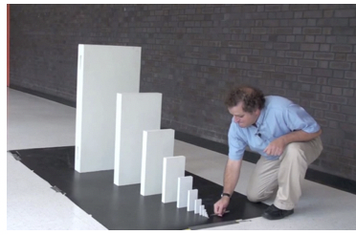
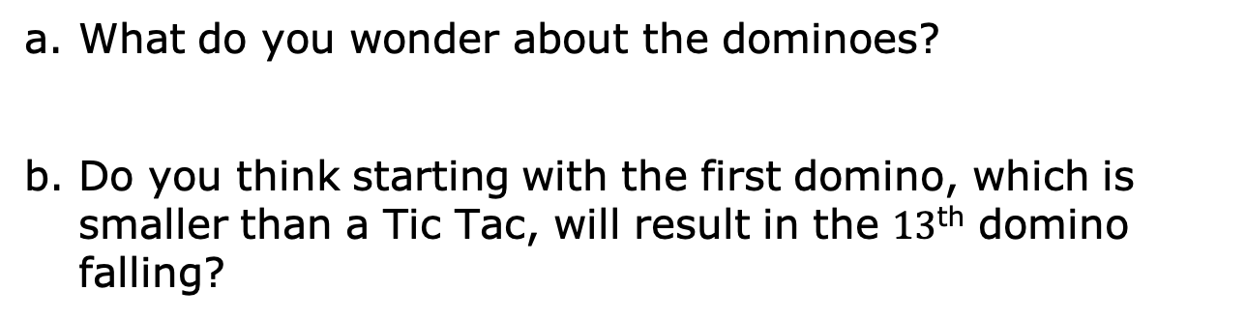
11.1.2 Exploration: Dominoes and Stickers
volume 2, pg. 156

Slide 10
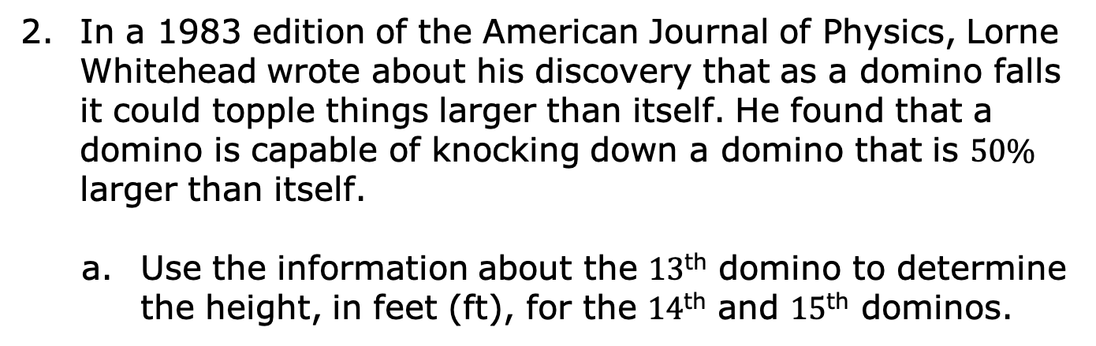
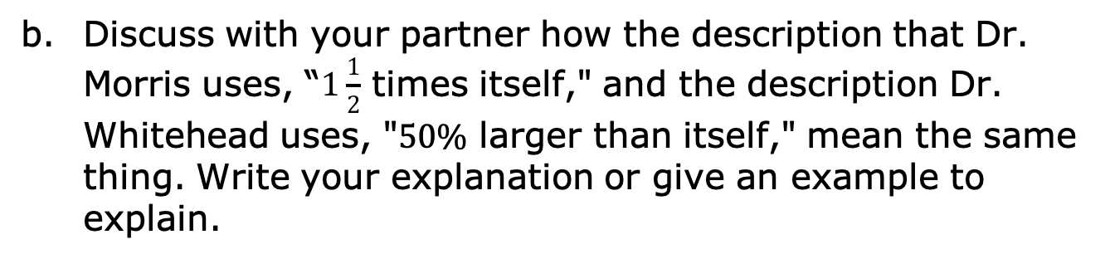
Domino | Height (ft)
13th | 3.2
14th
15th
volume 2, pg. 156

Slide 11
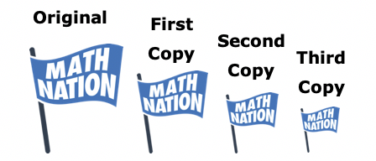
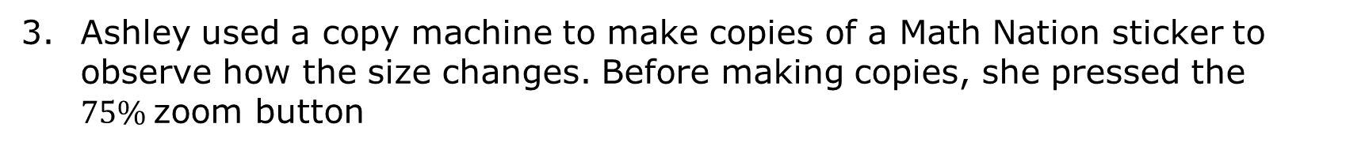
Ashley used a copy machine to make copies of a Math Nation sticker to observe how the size changes. Before making copies, she pressed the $75\%$zoom button
She made the first copy of the sticker.
To make the second copy, she removed the original sticker from the copy machine and replaced it with the first copy of the sticker. She then pressed copy.
To make the third copy, she removed the first copy of the sticker and replaced it with the second copy of the sticker. She then pressed copy.
How is each copy of the sticker related to the copy that was made before?
volume 2, pg. 157

Slide 12

Collaboration
volume 2, pg. 157

Slide 13


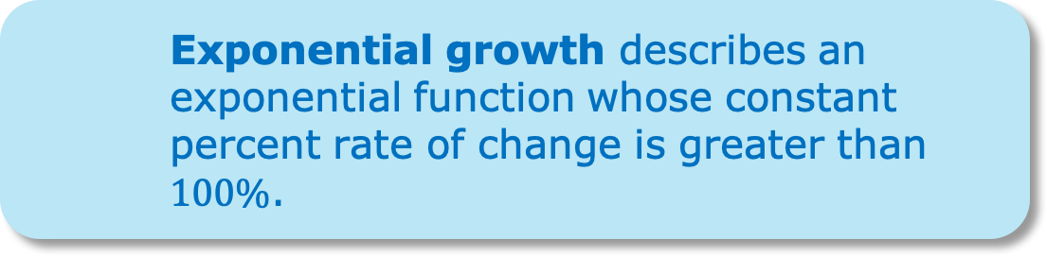

11.1.3 Collaboration: Graphs and Tables
There are two types of exponential functions: exponential growth and exponential decay.
An exponential function is a function with a constant percent rate of change.
volume 2, pg. 157

Slide 14
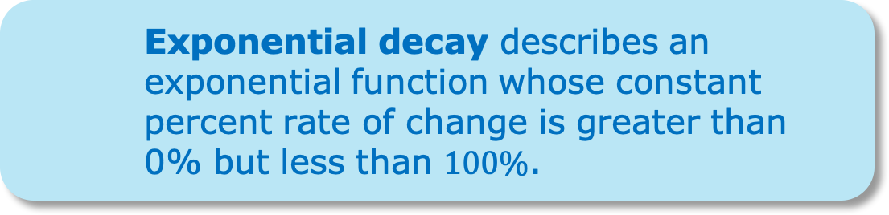
volume 2, pg. 157

Slide 15
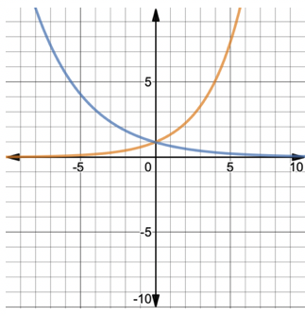
Use the descriptions of exponential growth and decay to determine what the orange graph represents and what the blue graph represents.
Orange:
Exponential growth
Exponential decay
Blue:
Exponential growth
Exponential decay
volume 2, pg. 157

Slide 16
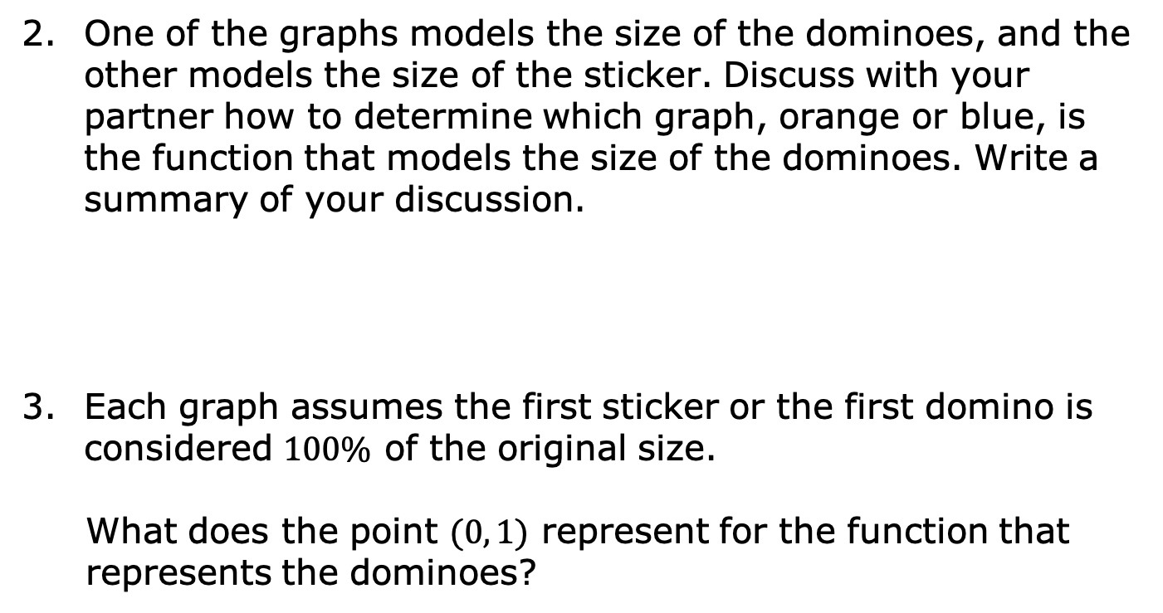
volume 2, pg. 158

Slide 17
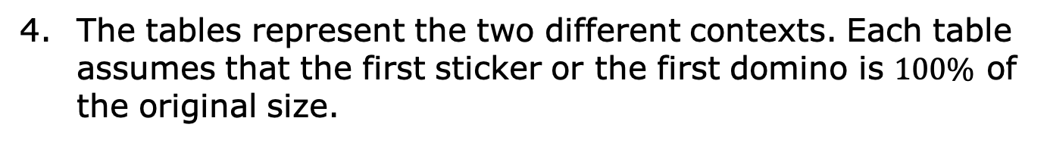
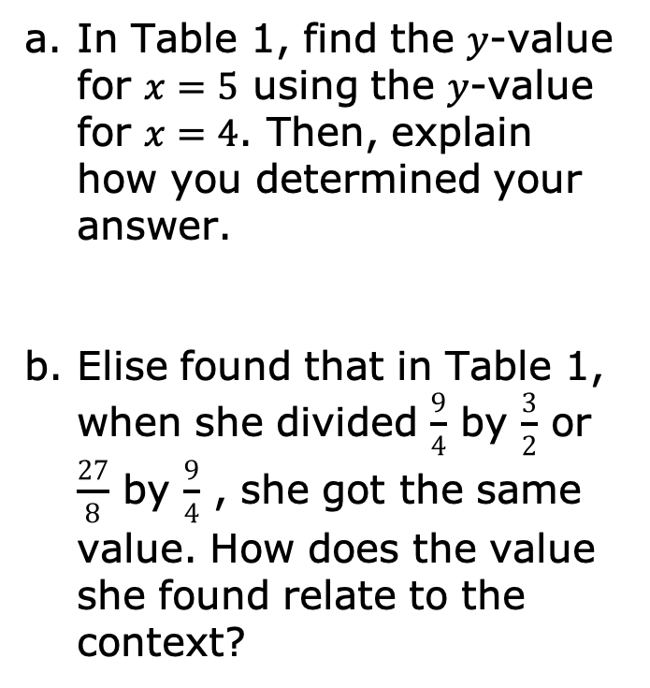








Table 1
x | y
0 | 1
1
2
3
4
5
Table 2
x | y
0 | 1
1
2
3
4
5
volume 2, pg. 158

Slide 18
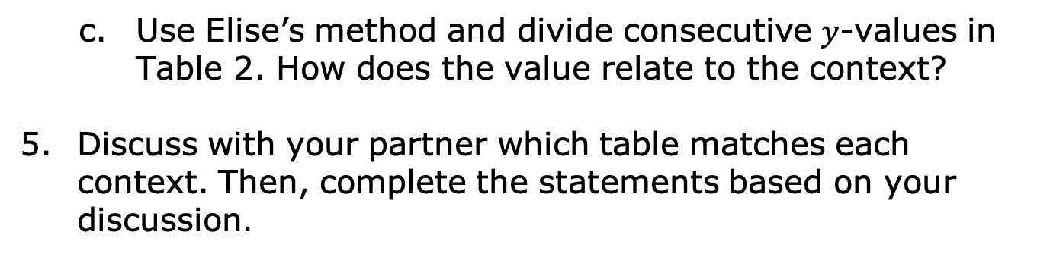

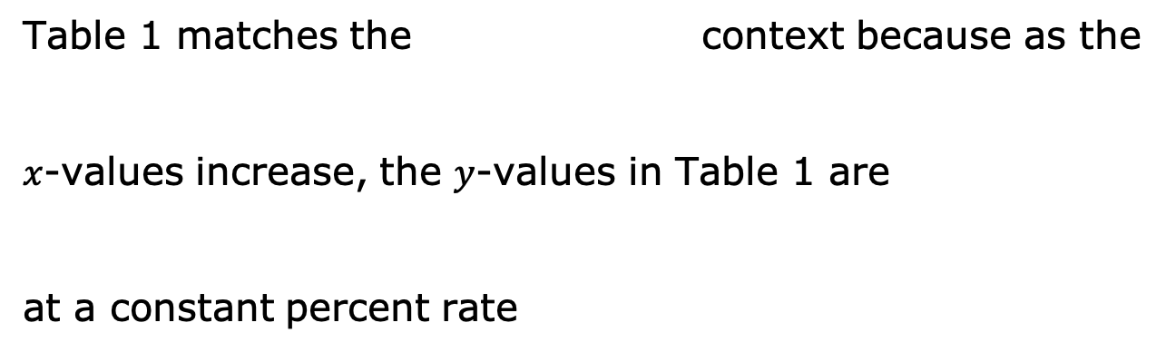


volume 2, pg. 159

Slide 19

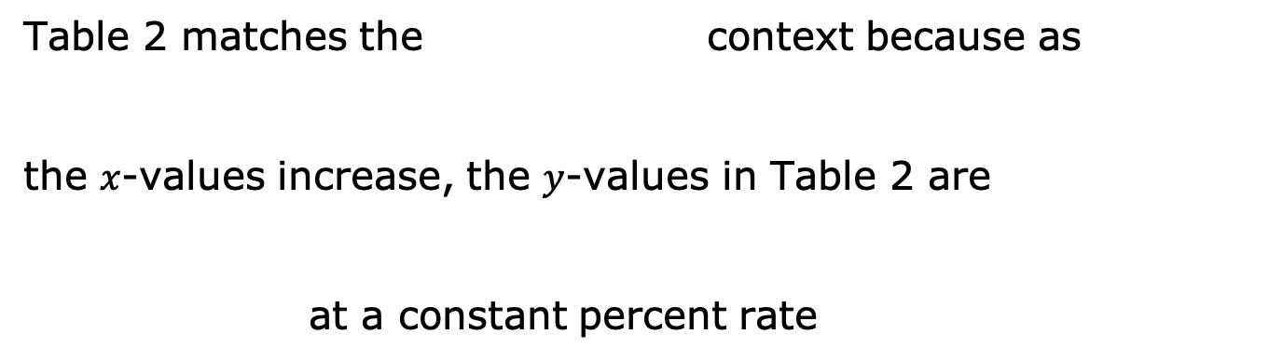


volume 2, pg. 159

Slide 20

Bring It Together
volume 2, pg. 159

Slide 21

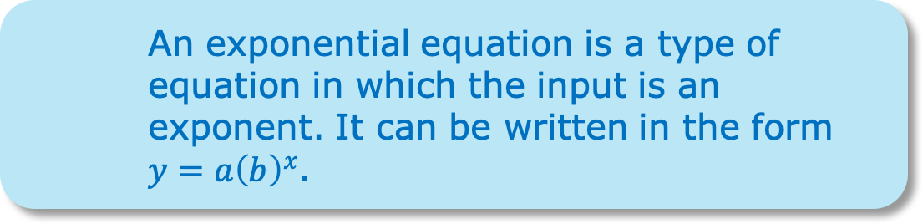
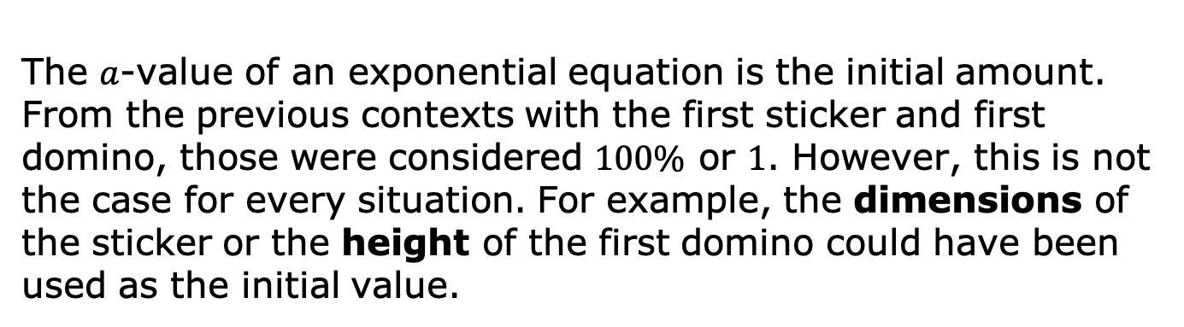
11.1.4 Bring It Together: Exponential Equations
volume 2, pg. 159

Slide 22





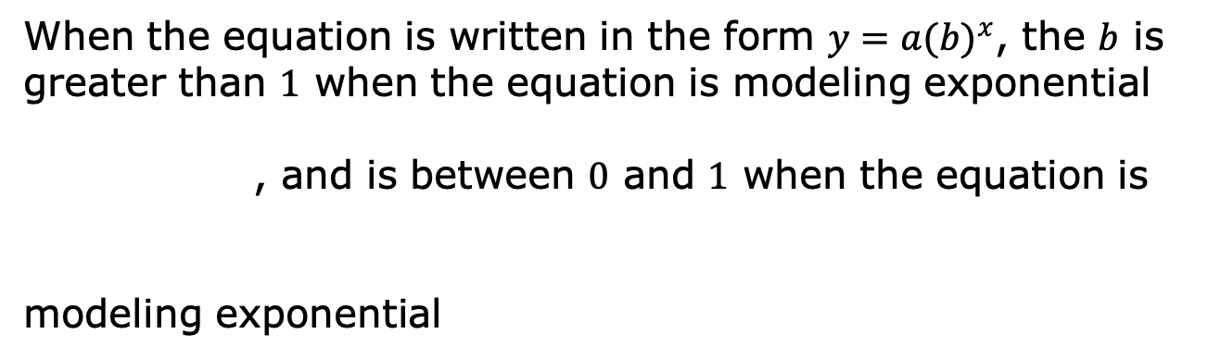


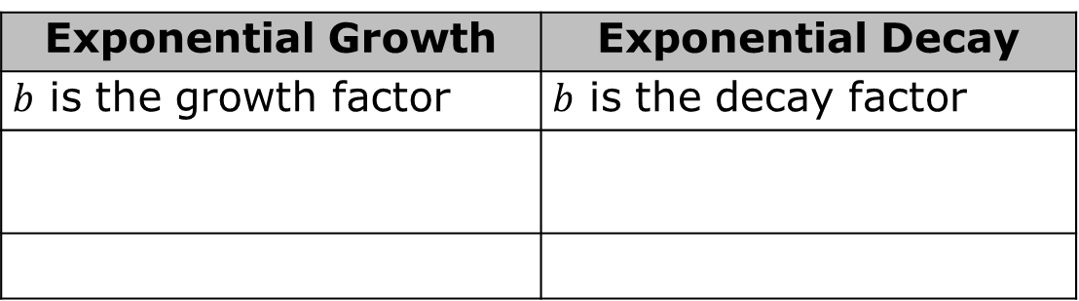
Exponential Growth | Exponential Decay
$b$ is the growth factor | $b$ is the decay factor
Complete the statement.
volume 2, pg. 159

Slide 23
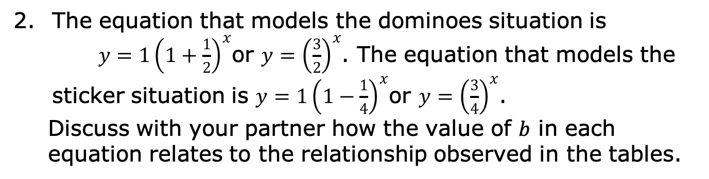
volume 2, pg. 160

Slide 24

Your Turn
volume 2, pg. 160

Slide 25
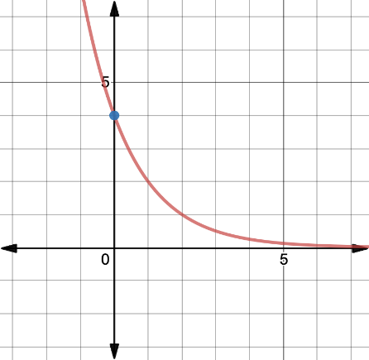
11.1.5 Your Turn!
Determine if each representation of a function is an example of exponential decay or exponential growth. Justify your selection.
Representation | Type of Exponential Function
 | Exponential decay Exponential growth
Justification
volume 2, pg. 160

Slide 26

Representation | Type of Exponential Function
 | Exponential decay Exponential growth
Justification
volume 2, pg. 160

Slide 27
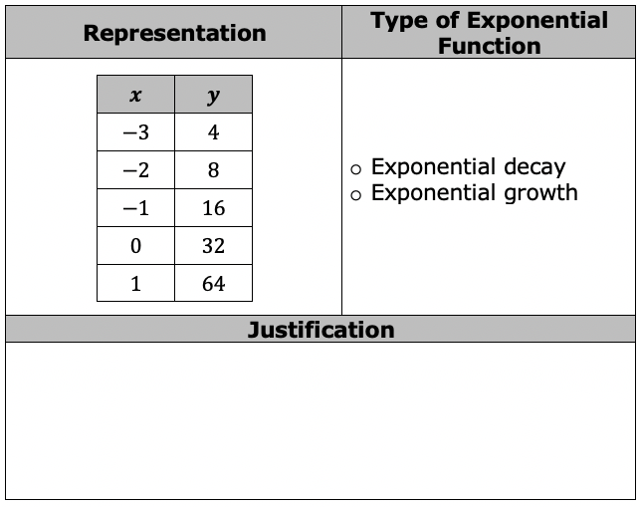
volume 2, pg. 161

Slide 28

Representation | Type of Exponential Function
 | Exponential decay Exponential growth
Justification
volume 2, pg. 161

Slide 29
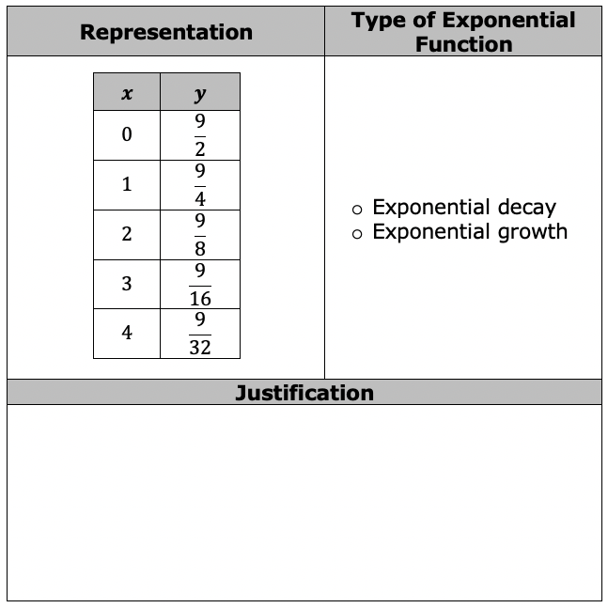
volume 2, pg. 161

Slide 30

Wrap-Up
volume 2, pg. 162

Slide 31
11.1.6 Wrap-Up: Reflection
Complete the table.
The terms and information used in the lesson that I knew were … | Something I wondered during the lesson was … | Something I learned during the lesson was …
volume 2, pg. 162

